Slide 1



Database Technologies 1. Knack
Knack was founded in 2010 and is the easiest online database tool I’ve come across.
They’re a SaaS-based online tool that allows their users to easily structure, connect, and extend data with no coding required.
Knack has an impressive customer base, including Intel, Capital One, HP, Spotify, Panasonic, Zendesk, Honda, Harvard University, and many others.
To use Knack , you start by structuring your data with the main columns that you need – including things like name, email, address, phone number, and any number of custom categories.

Slide 2

2. Microsoft SQL Server
Microsoft SQL Server is one of the most effective and sought after database software.
This relational DBMS server is perfect for storing and retrieving multiple requests at once.

Slide 3

3. MYSQL
MySQL is an open-source relational database system. The majority of the web hosting providers bundle MySQL in their basic packages. Hence, it is popular among both amateur and professional web designers.

Slide 4

4. Amazon RDS
Amazon RDS is a stable and capable relational Database-as-a-Service (DBaaS) that is at par with other competent offerings from Amazon Web Services (AWS). It is a good option for experienced data scientists, users, and digital-native companies.

Slide 5
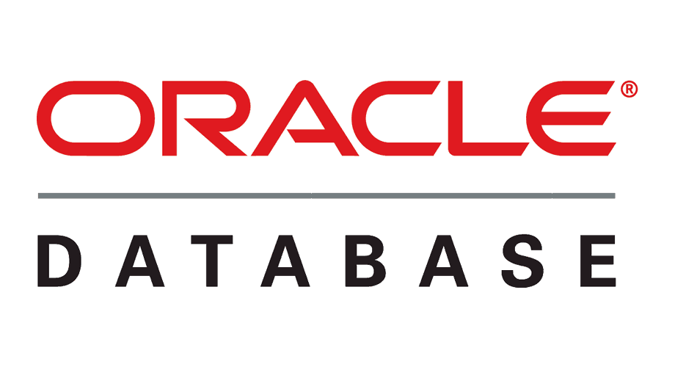
5. Oracle RDBMS
Oracle RDBMS is one of the most object-relational DBMS tools that has introduced some crucial capabilities in its latest version. It enables businesses with enterprise-scale database technology that can be stored on-premises or in the cloud

Slide 6

6. SQL Developer
SQL Developer offers secure connection capabilities with many database technologies.
It provides vast flexibility and a great variety of tools that can be leveraged for any purpose.
Moreover, it helps in simplifying the management and development of the Oracle database in the cloud or traditional deployments.

Slide 7
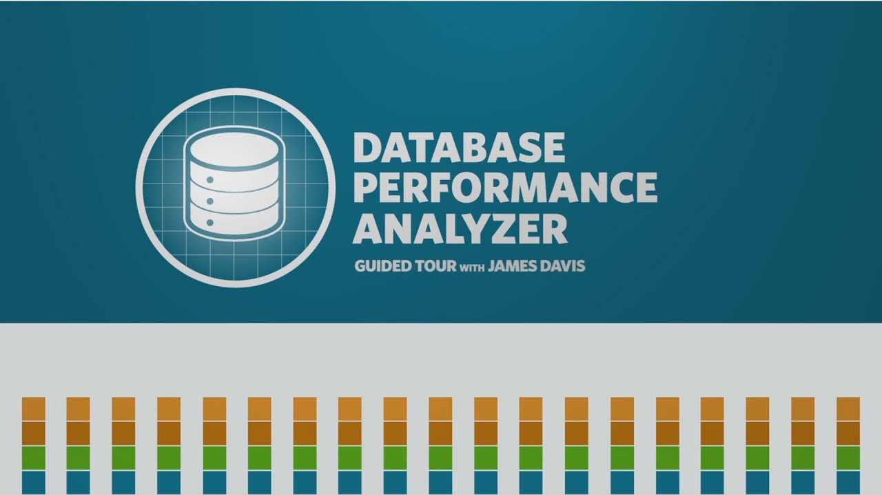
7. Database Performance Analyzer
With Database Performance Analyzer, the database performance guessing game is over.
Database performance analysis is now easy to do, and you can get results without leaving your desk.

Slide 8
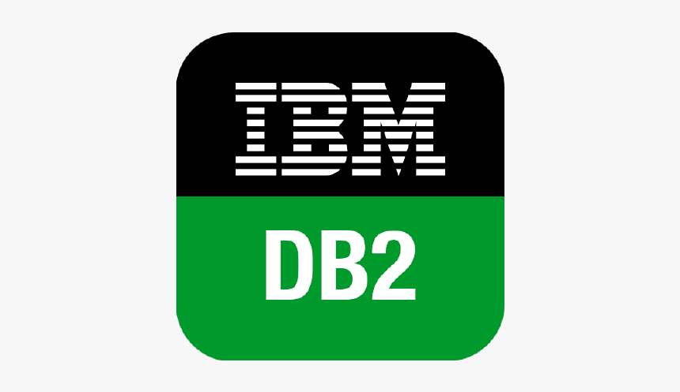
8. IBM Db2
IBM Db2 provides solutions for the Operational Database, Data Lake, Data Warehouse, and Fast Data. It is, without a doubt, one of the ideal database software for the most demanding workloads.

Slide 9

9. EMS SQL Manager
EMS SQL Manager enables you to create data analytics components within one dashboard.
It also offers robust vendor support that is capable of servicing all of your online database activities.

